Slide 1
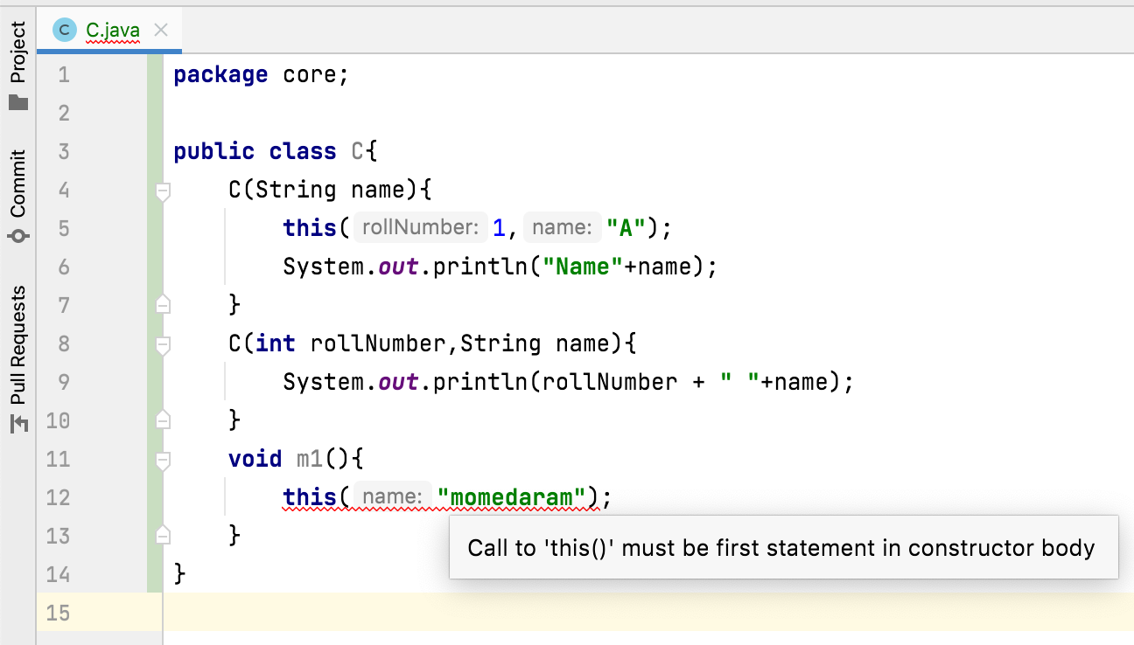
Can we use this() and super() in a method?
No, we can’t use this() and super() in a method.
We can use this() and super() only inside the constructors.

